Slide 1

Mepco Schlenk Engineering College (Autonomous)
YOUR HANDYMAN
23CS553 – Mini Project III
Guided By,
Dr. G. Ananthi, AP(Sl.Gr.)
Dr. Karkuzhali, AP(Sr.Gr.)
Department of CSE
S. Santhana Pandi (9517202304141)
B. Sivakavi (9517202304158)
M.P. Nitharsan (9517202304104)
Department of Computer Science and Engineering
1

Slide 2
Mepco Schlenk Engineering College (Autonomous)
Problem Description:
In our daily life, people often need household or professional services like plumbing, electrical work, carpentry, or cleaning. Finding reliable and skilled service providers can be difficult and time-consuming. Traditional methods such as calling individual workers, asking for personal referrals, or relying on offline booking systems are often inefficient, slow, and sometimes unreliable. This creates problems for both users and service providers. Users may not get services on time, and service providers may not get proper bookings or schedules.
The “Your Handyman” project aims to solve these problems by creating a web-based platform that connects users with service providers easily and efficiently. Users can browse available services, check details of service providers, book appointments, and track the status of their requests. Real-time updates and notifications help users stay informed about their bookings and reduce waiting time or confusion
7 November 2025
7 November 2025
7 November 2025
7 November 2025
7 November 2025
7 November 2025
Department of Computer Science and Engineering
2

Slide 3
Mepco Schlenk Engineering College (Autonomous)
Objective:
The main objective of the "Your Handyman" system is:
To create an easy-to-use platform where users can view, book, and review handyman services like maintenance, installation, repair, cleaning, renovation, and Painting.
To allow admins to manage service appointments, add or update services, and keep track of past records.
To make the whole process of finding, booking, and getting services quick, clear, and reliable for everyone.
To provide a way for users to contact service provider and customer care for any service issues.
To maintain a complete history of services to ensure better tracking, quality control, and future improvements.
7 November 2025
7 November 2025
Department of Computer Science and Engineering
3

Slide 4
Mepco Schlenk Engineering College (Autonomous)
Outcomes:
By using the "Your Handyman" system:
Users can easily find and book trusted handyman services from one place.
Admins can efficiently manage all service-related activities in a single system.
Service requests and bookings will be handled faster, saving time for both users and providers.
Complaints and feedback will help improve service quality over time.
A proper record of past services will make tracking and future planning easier.
Overall customer satisfaction will increase due to better communication and reliability.
7 November 2025
7 November 2025
7 November 2025
7 November 2025
7 November 2025
7 November 2025
7 November 2025
Department of Computer Science and Engineering
4

Slide 5
Mepco Schlenk Engineering College (Autonomous)
Architecture Design:
The architecture of the proposed work which ensures smooth data flow between all layers. When a user makes a request (like booking a service), it is processed by the backend and stored in the database, with the response returned to the frontend in real time. This design provides high performance, easy maintenance, and flexibility for future upgrades such as payment integration, ratings, and mobile app expansion.
Department of Computer Science and Engineering
5

Slide 6
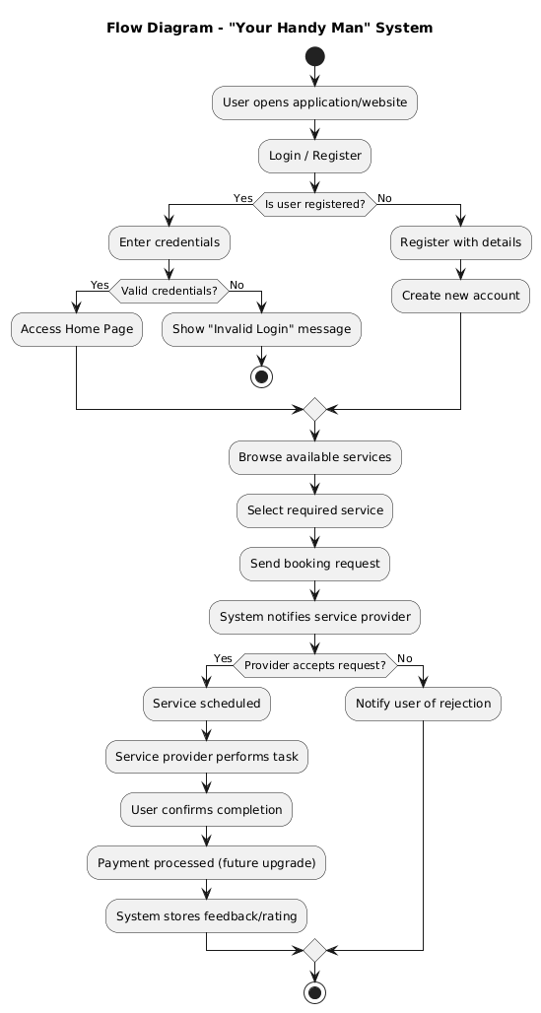
Mepco Schlenk Engineering College (Autonomous)
7 November 2025
Department of Computer Science and Engineering
6

Slide 7
Mepco Schlenk Engineering College (Autonomous)
7 November 2025
Department of Computer Science and Engineering
7

Slide 8
Mepco Schlenk Engineering College (Autonomous)
Database Description:
Listed below gives a description of database schemas used for “Your Handyman”
Users Table
Service Providers Table
Customers Table
Services Table
Reviews Table
Bookings Table
Provider Skills Table
Payments Table
7 November 2025
7 November 2025
Department of Computer Science and Engineering
8

Slide 9
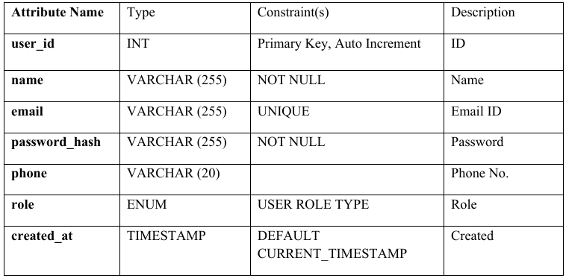
Mepco Schlenk Engineering College (Autonomous)
User Table:
users – stores all user accounts including super_admin, admin, customer, and service_provider.
7 November 2025
7 November 2025
Department of Computer Science and Engineering
9

Slide 10
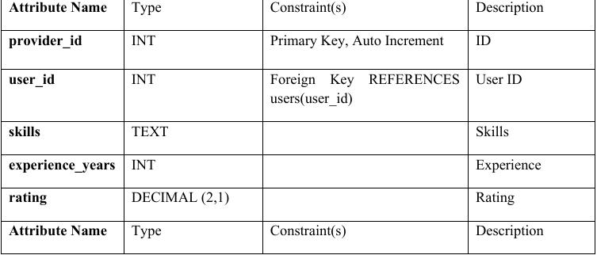
Mepco Schlenk Engineering College (Autonomous)
Service Providers
service_providers – contains provider-specific details like skills, experience, and ratings.
7 November 2025
7 November 2025
Department of Computer Science and Engineering
10

Slide 11
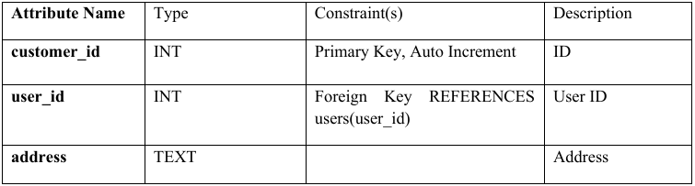
Mepco Schlenk Engineering College (Autonomous)
Customers Table
customers – stores customer-specific information such as address.
7 November 2025
7 November 2025
Department of Computer Science and Engineering
11

Slide 12
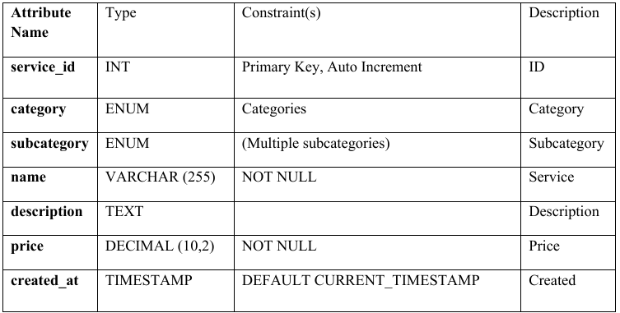
Mepco Schlenk Engineering College (Autonomous)
Services Table
services – lists all available services with categories, subcategories, descriptions, and prices.
7 November 2025
7 November 2025
Department of Computer Science and Engineering
12

Slide 13
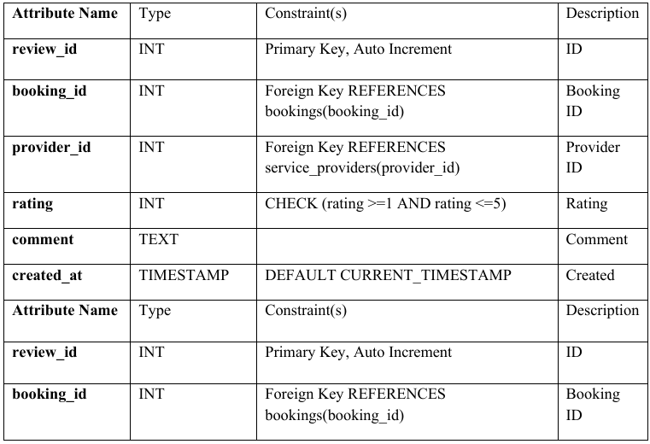
Mepco Schlenk Engineering College (Autonomous)
Reviews Table
reviews – maintains feedback and ratings for completed bookings.
7 November 2025
7 November 2025
Department of Computer Science and Engineering
13

Slide 14
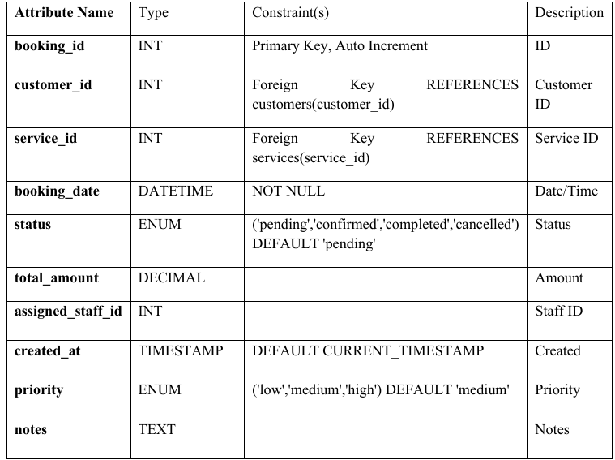
Mepco Schlenk Engineering College (Autonomous)
Bookings Table
bookings – records all service bookings with status, priority, assigned staff, and notes.
7 November 2025
Department of Computer Science and Engineering
14

Slide 15
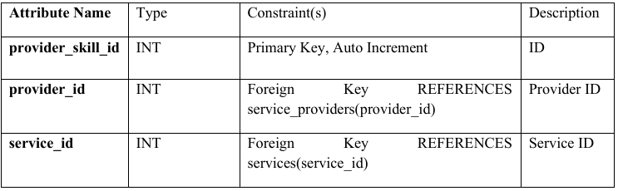
Mepco Schlenk Engineering College (Autonomous)
Provider Skills Table
provider_skills – maps service providers to the services they offer.
7 November 2025
Department of Computer Science and Engineering
15

Slide 16
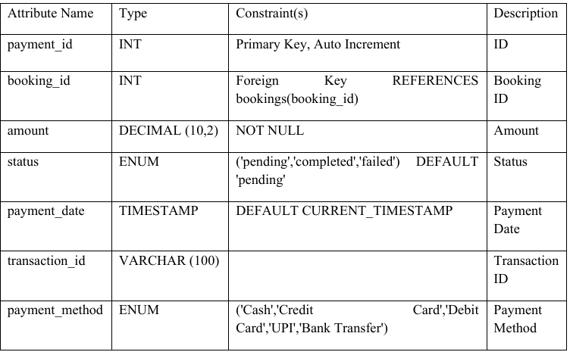
Mepco Schlenk Engineering College (Autonomous)
Payments Table
payments – stores all payment details for bookings including amount, status, and method.
7 November 2025
Department of Computer Science and Engineering
16

Slide 17
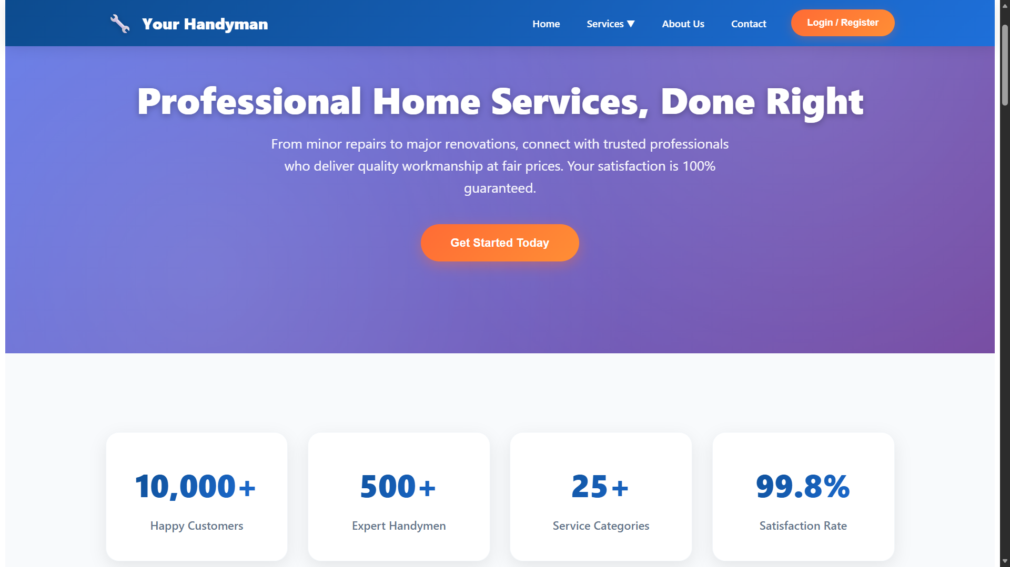
Mepco Schlenk Engineering College (Autonomous)
Home Page:
7 November 2025
7 November 2025
7 November 2025
Department of Computer Science and Engineering
17

Slide 18
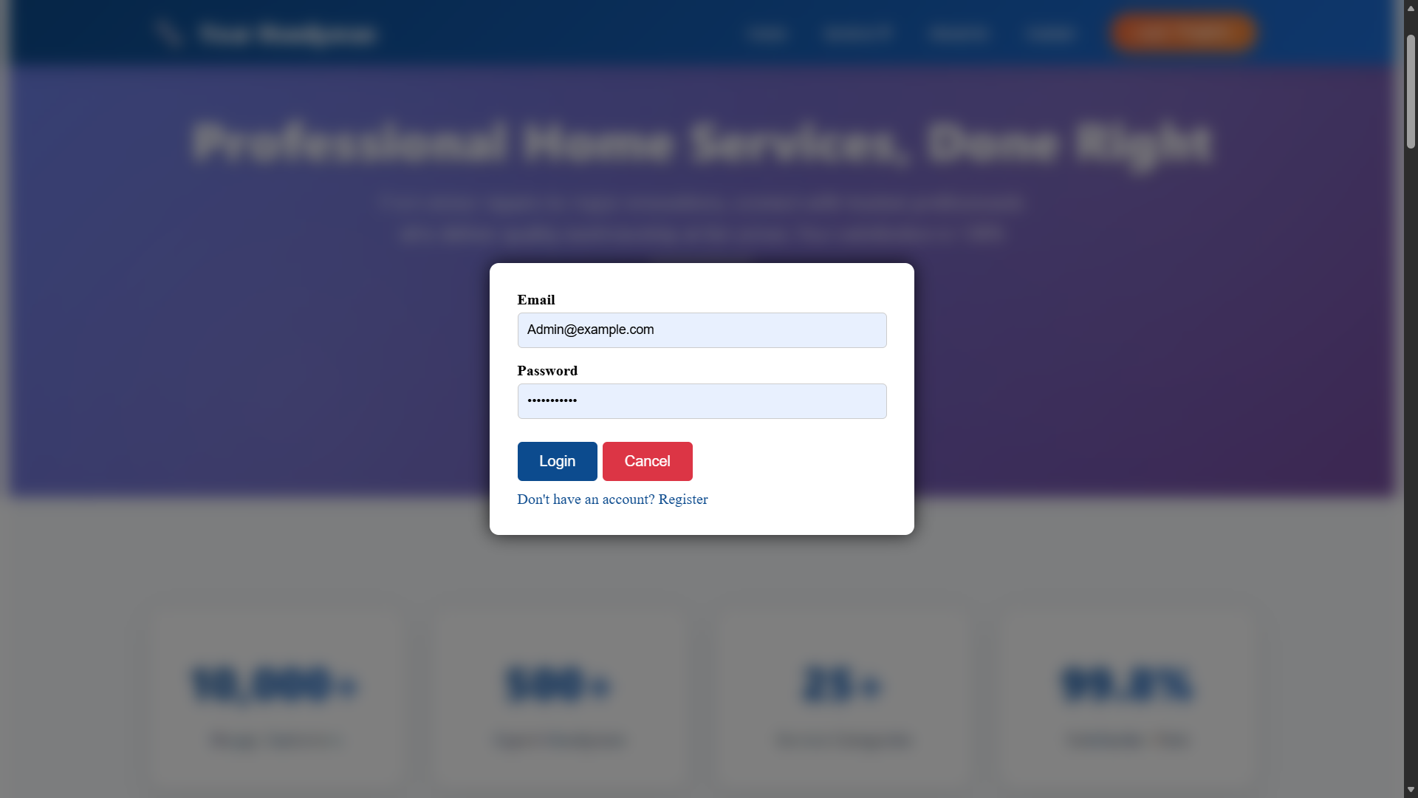
Mepco Schlenk Engineering College (Autonomous)
Login Page:
7 November 2025
7 November 2025
7 November 2025
Department of Computer Science and Engineering
18

Slide 19
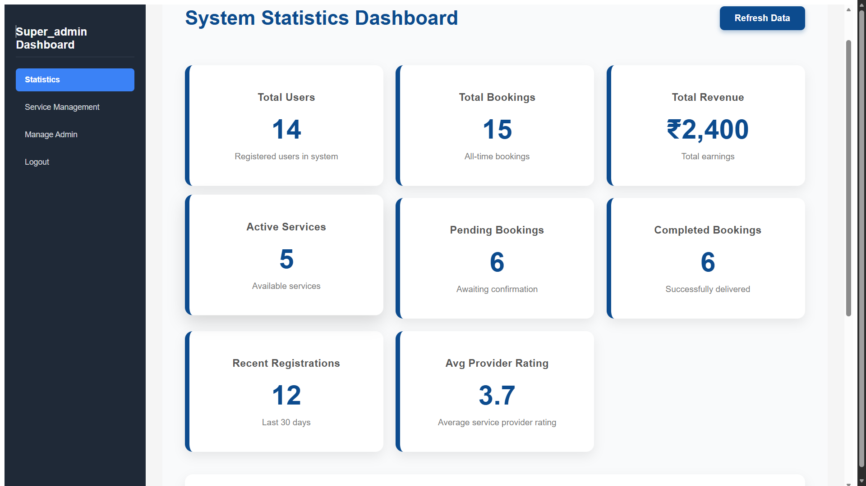
Mepco Schlenk Engineering College (Autonomous)
Super Admin Dashboard – Statistics:
7 November 2025
7 November 2025
7 November 2025
Department of Computer Science and Engineering
19

Slide 20
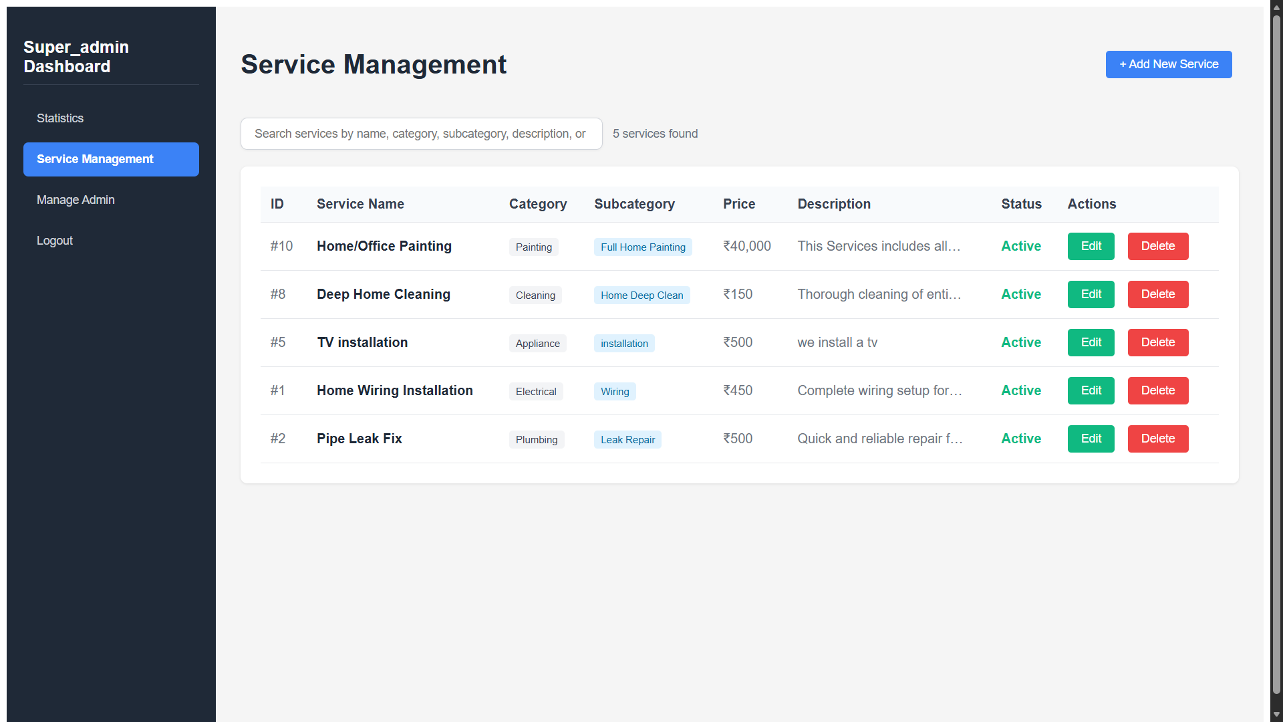
Mepco Schlenk Engineering College (Autonomous)
Super Admin Dashboard – Service Management:
7 November 2025
7 November 2025
7 November 2025
Department of Computer Science and Engineering
20

Slide 21
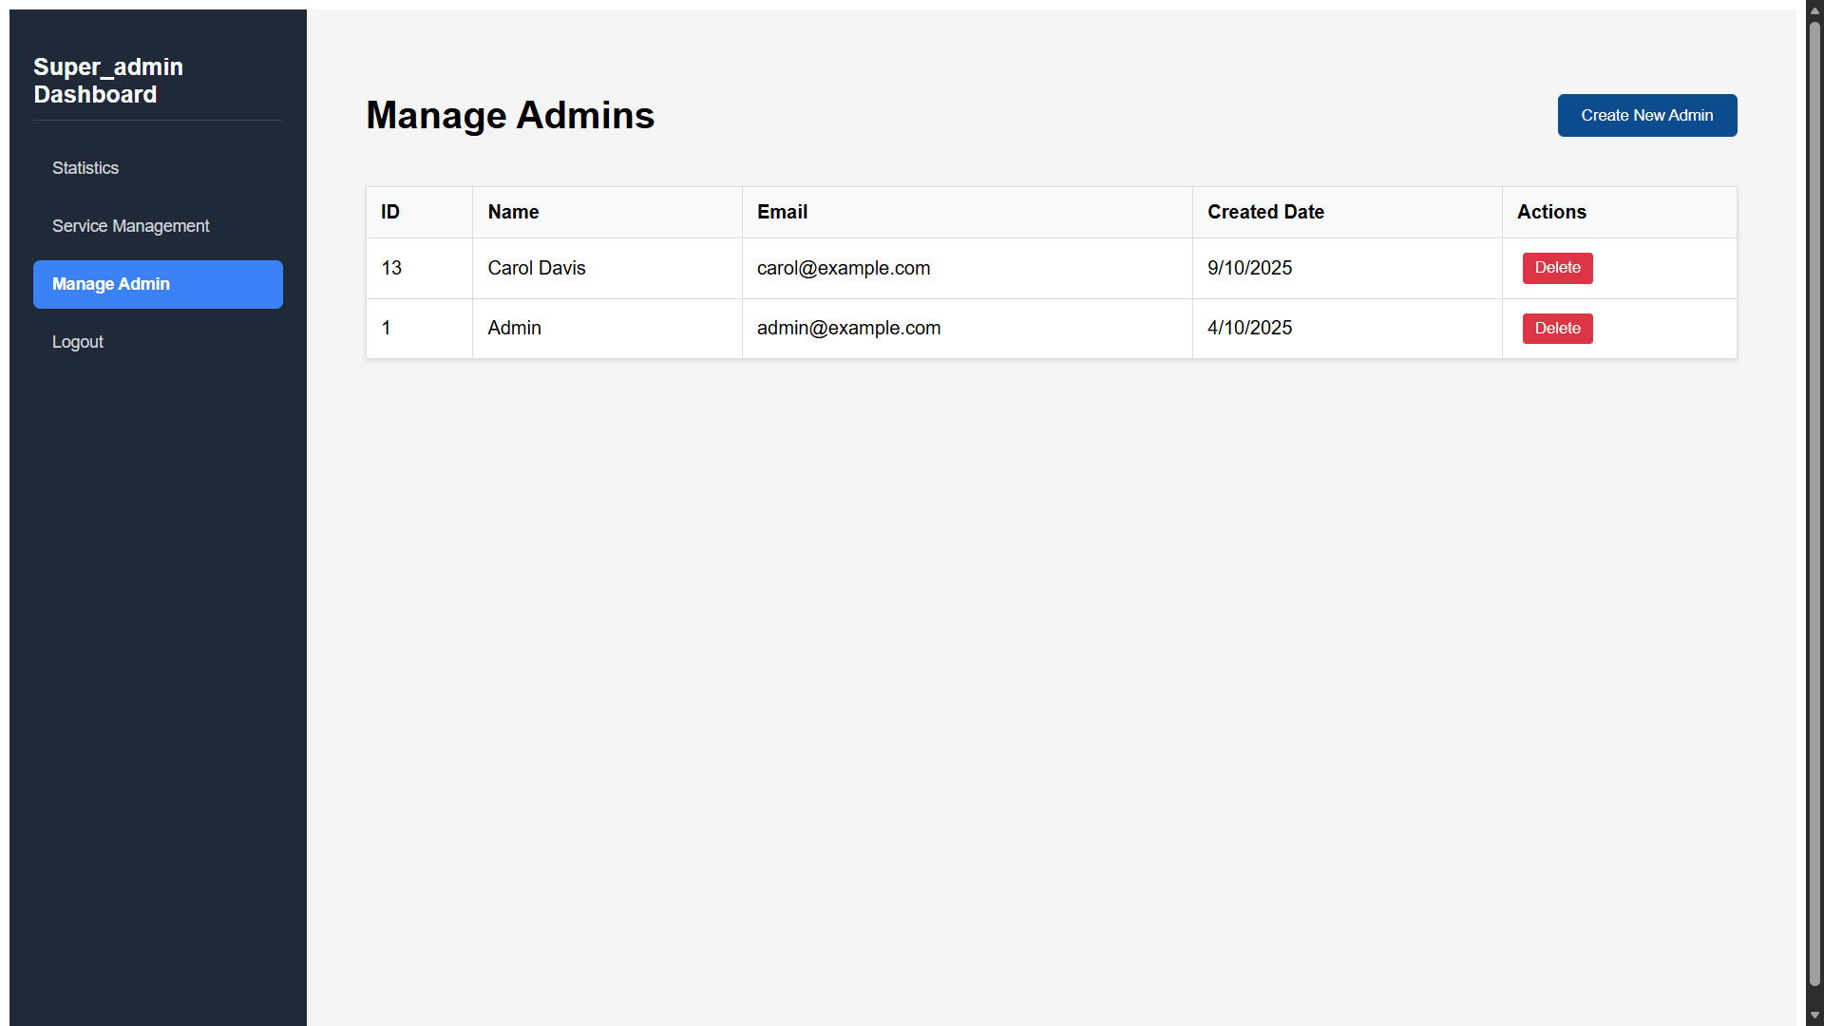
Mepco Schlenk Engineering College (Autonomous)
Super Admin Dashboard – Admin Management:
7 November 2025
7 November 2025
7 November 2025
Department of Computer Science and Engineering
21

Slide 22
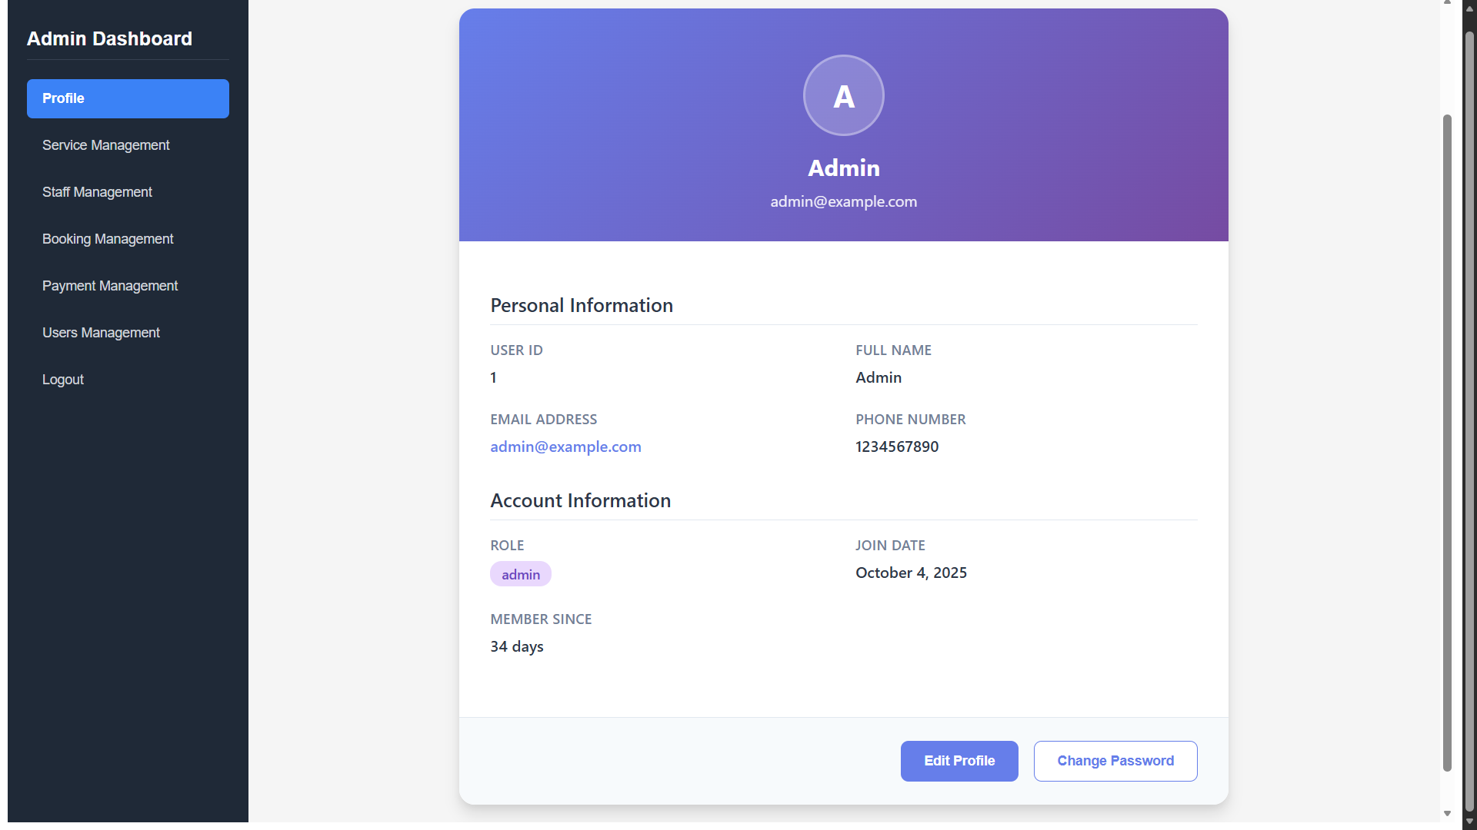
Mepco Schlenk Engineering College (Autonomous)
Admin Dashboard - Profile:
7 November 2025
7 November 2025
7 November 2025
Department of Computer Science and Engineering
22

Slide 23
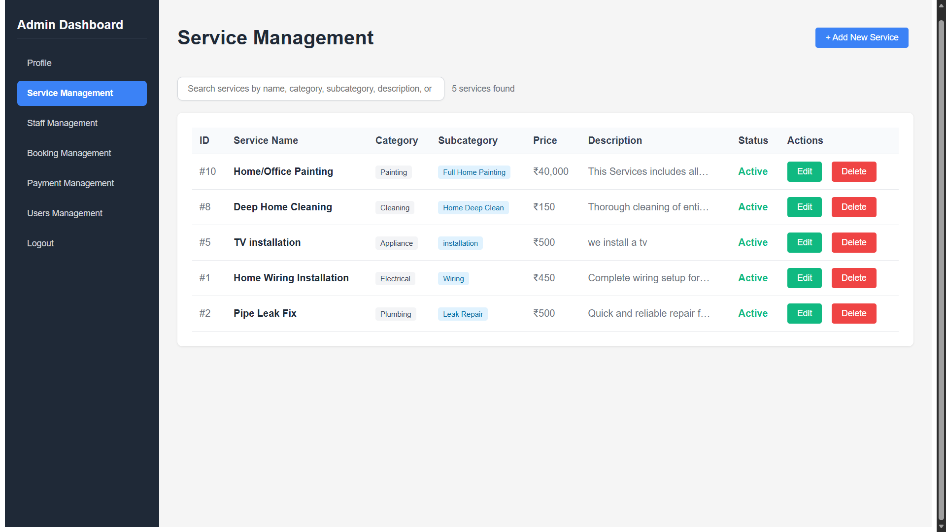
Mepco Schlenk Engineering College (Autonomous)
Admin Dashboard – Service Management:
7 November 2025
7 November 2025
7 November 2025
Department of Computer Science and Engineering
23

Slide 24
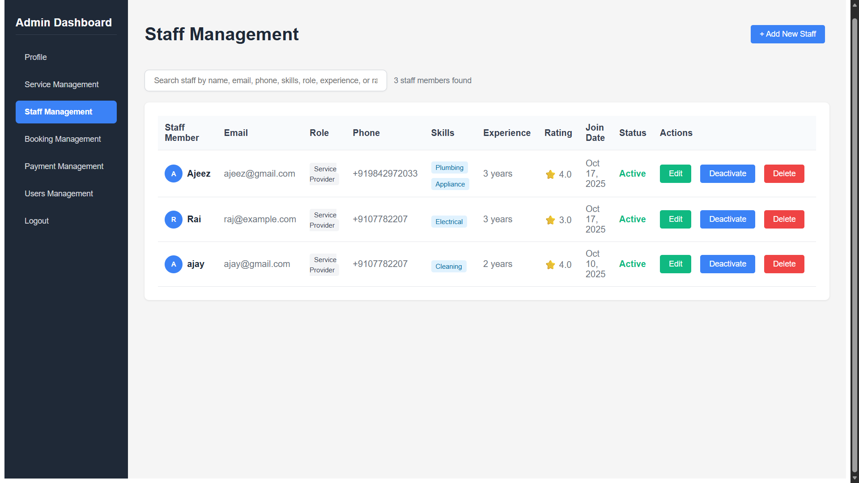
Mepco Schlenk Engineering College (Autonomous)
Admin Dashboard – Staff Management:
7 November 2025
7 November 2025
7 November 2025
Department of Computer Science and Engineering
24

Slide 25
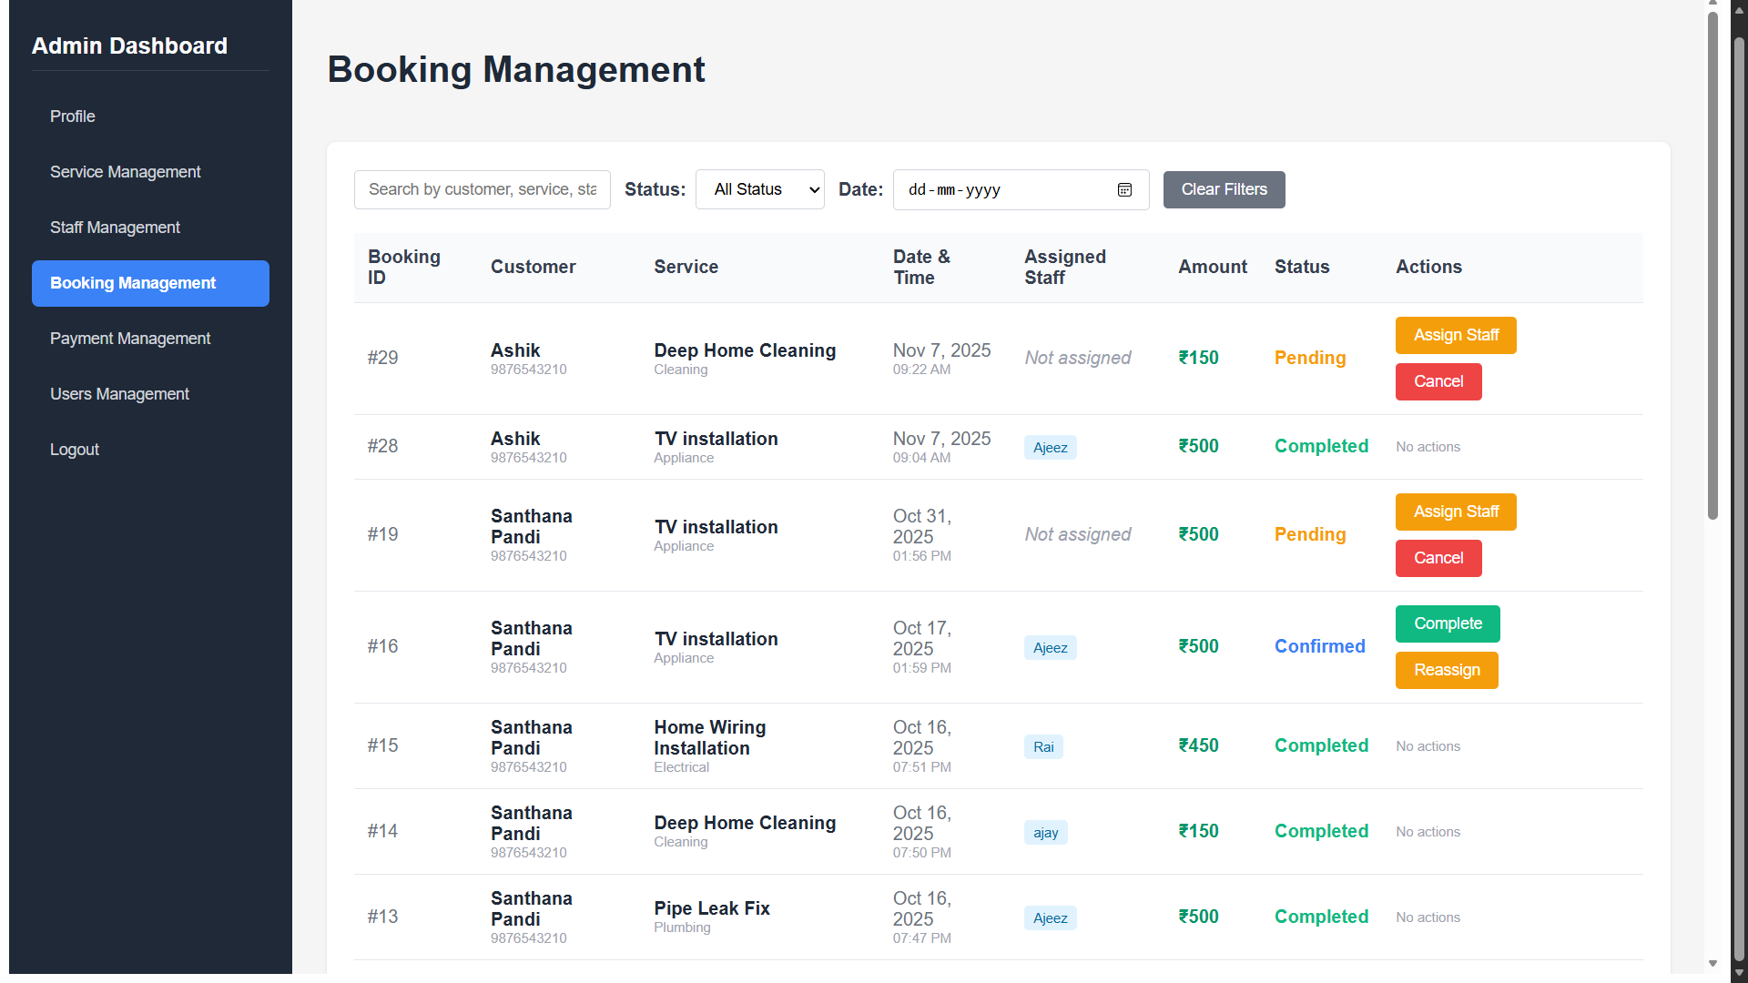
Mepco Schlenk Engineering College (Autonomous)
Admin Dashboard – Booking Management:
7 November 2025
7 November 2025
7 November 2025
Department of Computer Science and Engineering
25

Slide 26
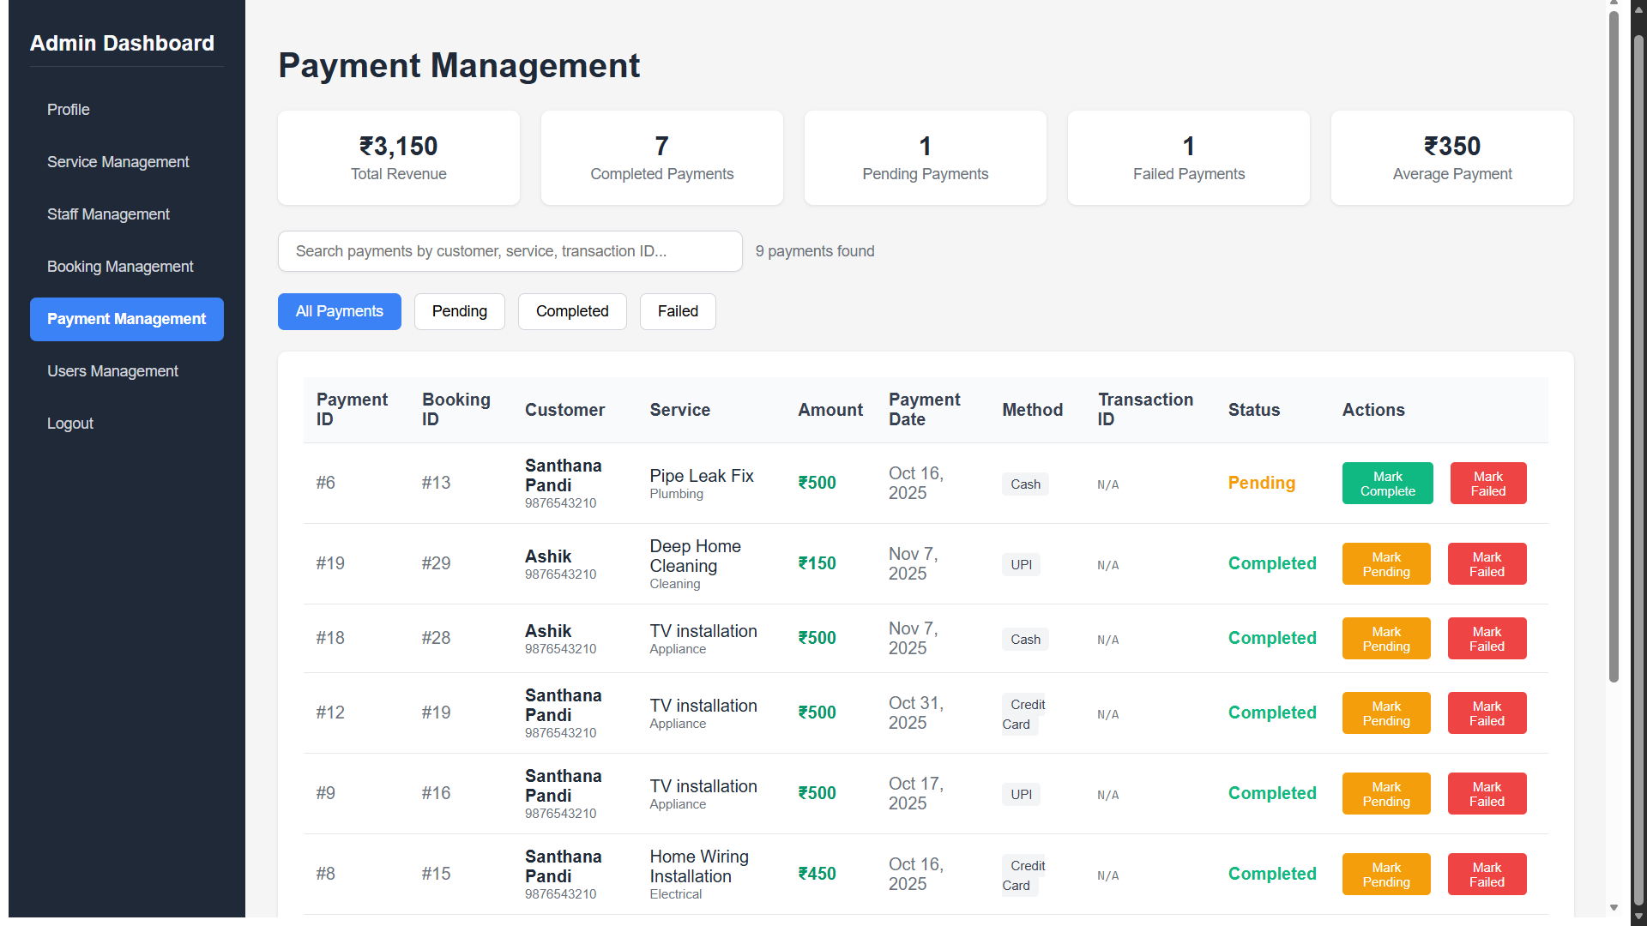
Mepco Schlenk Engineering College (Autonomous)
Admin Dashboard – Payment Management:
7 November 2025
7 November 2025
7 November 2025
Department of Computer Science and Engineering
26

Slide 27
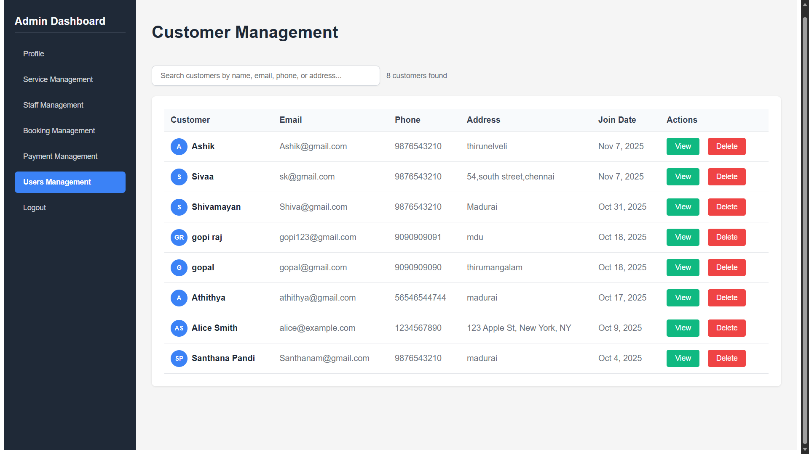
Mepco Schlenk Engineering College (Autonomous)
Admin Dashboard – User Management:
7 November 2025
7 November 2025
7 November 2025
Department of Computer Science and Engineering
27

Slide 28
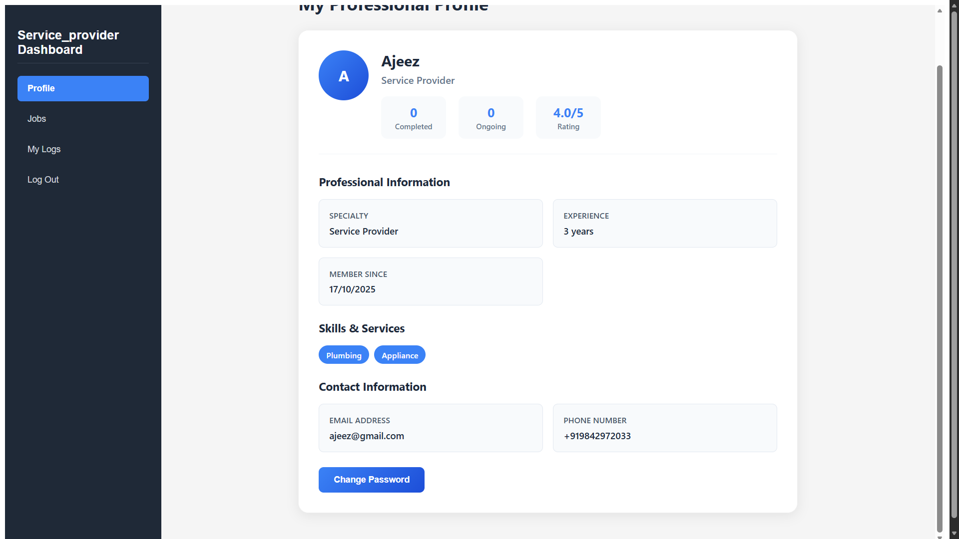
Mepco Schlenk Engineering College (Autonomous)
Service Provider Dashboard – Profile
7 November 2025
7 November 2025
7 November 2025
Department of Computer Science and Engineering
28

Slide 29
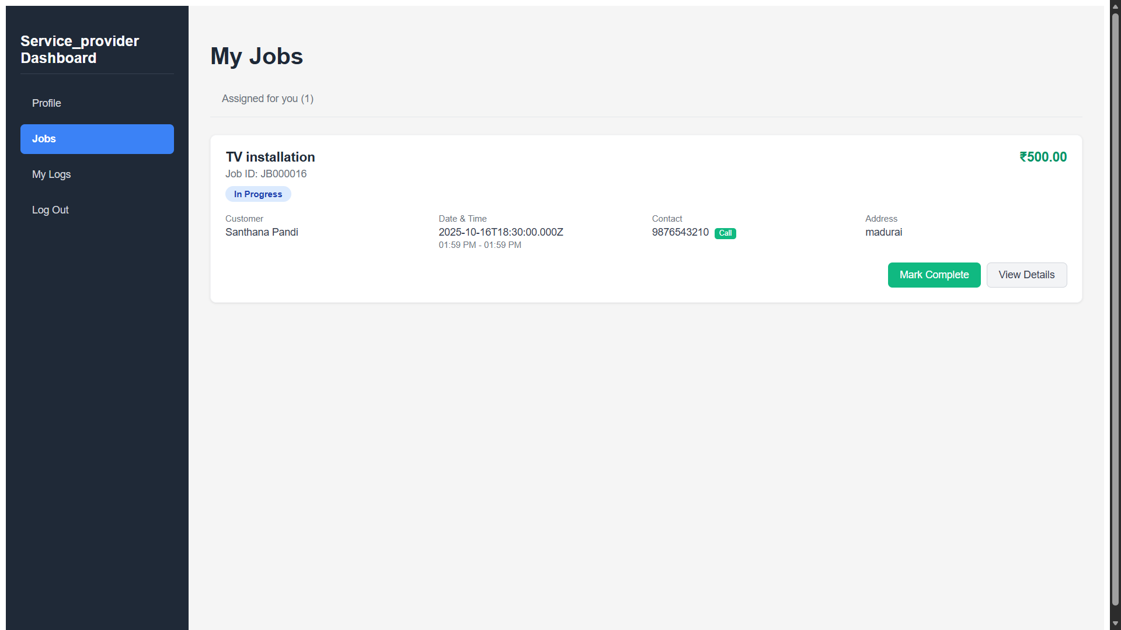
Mepco Schlenk Engineering College (Autonomous)
Service Provider Dashboard – Job Management
7 November 2025
7 November 2025
7 November 2025
Department of Computer Science and Engineering
29

Slide 30
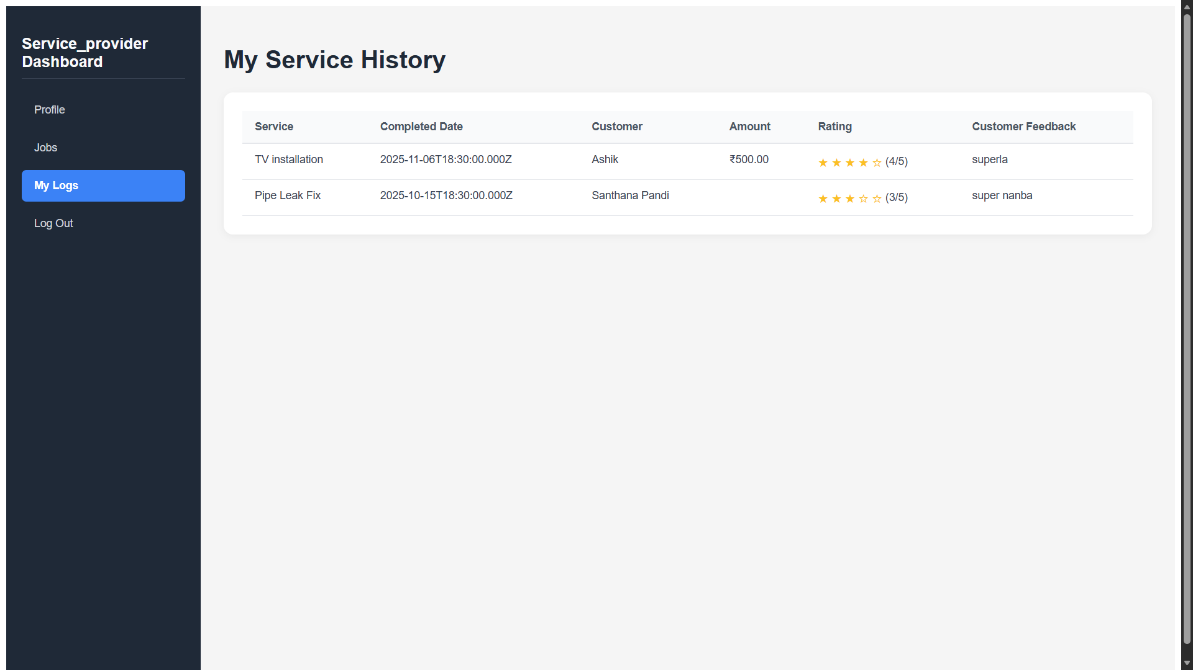
Mepco Schlenk Engineering College (Autonomous)
Service Provider Dashboard – History
7 November 2025
7 November 2025
7 November 2025
Department of Computer Science and Engineering
30

Slide 31
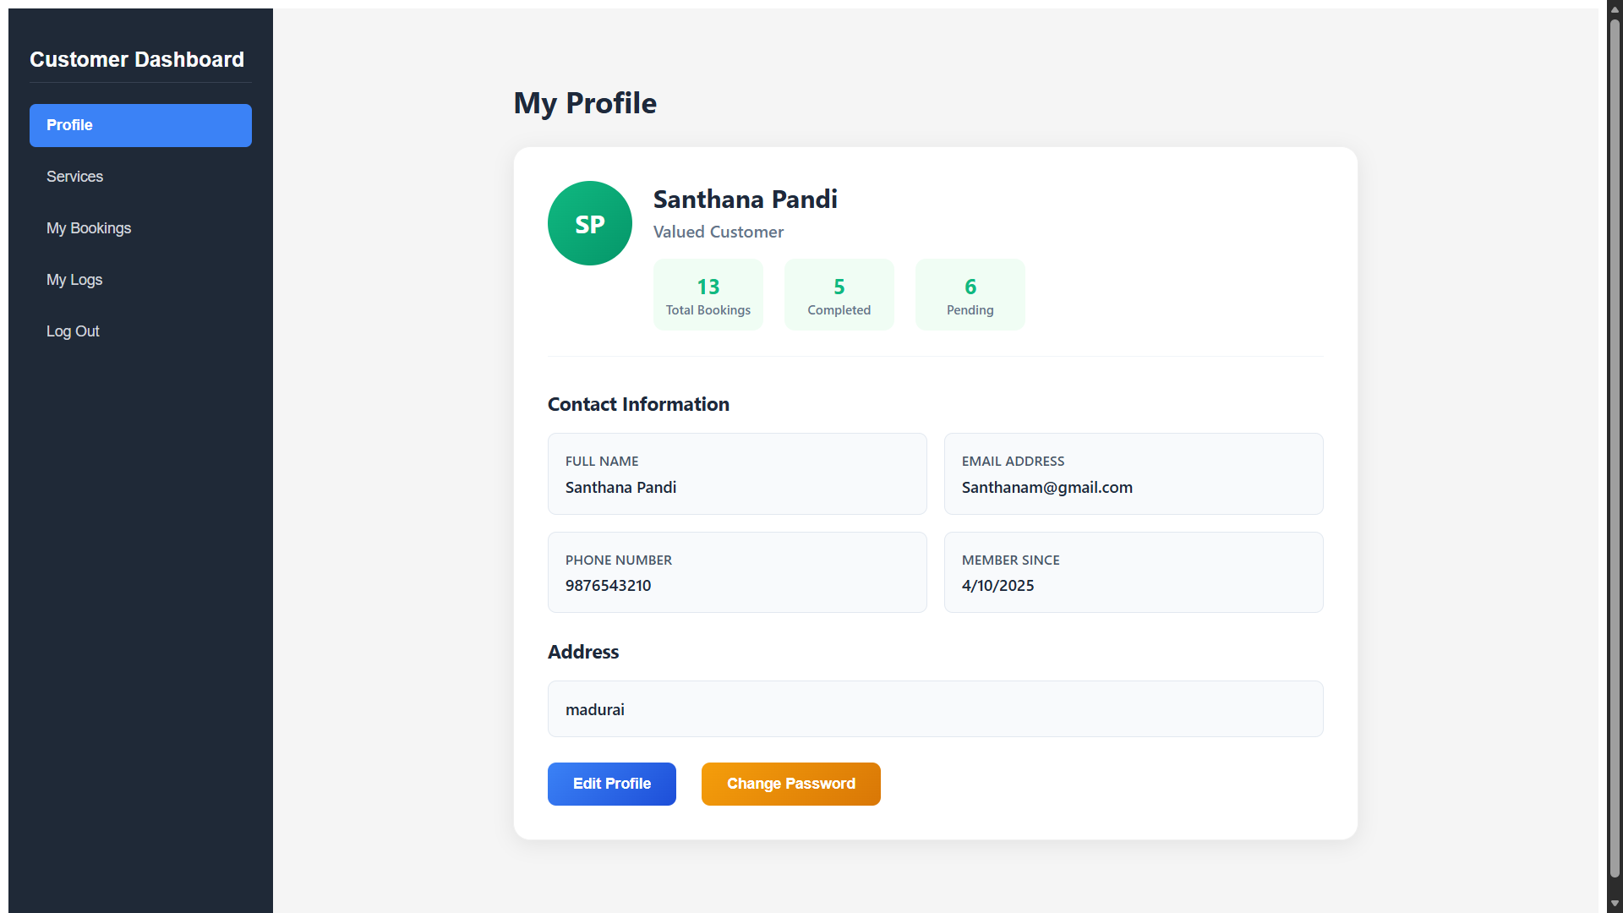
Mepco Schlenk Engineering College (Autonomous)
Customer Dashboard – Profile
7 November 2025
7 November 2025
7 November 2025
Department of Computer Science and Engineering
31

Slide 32
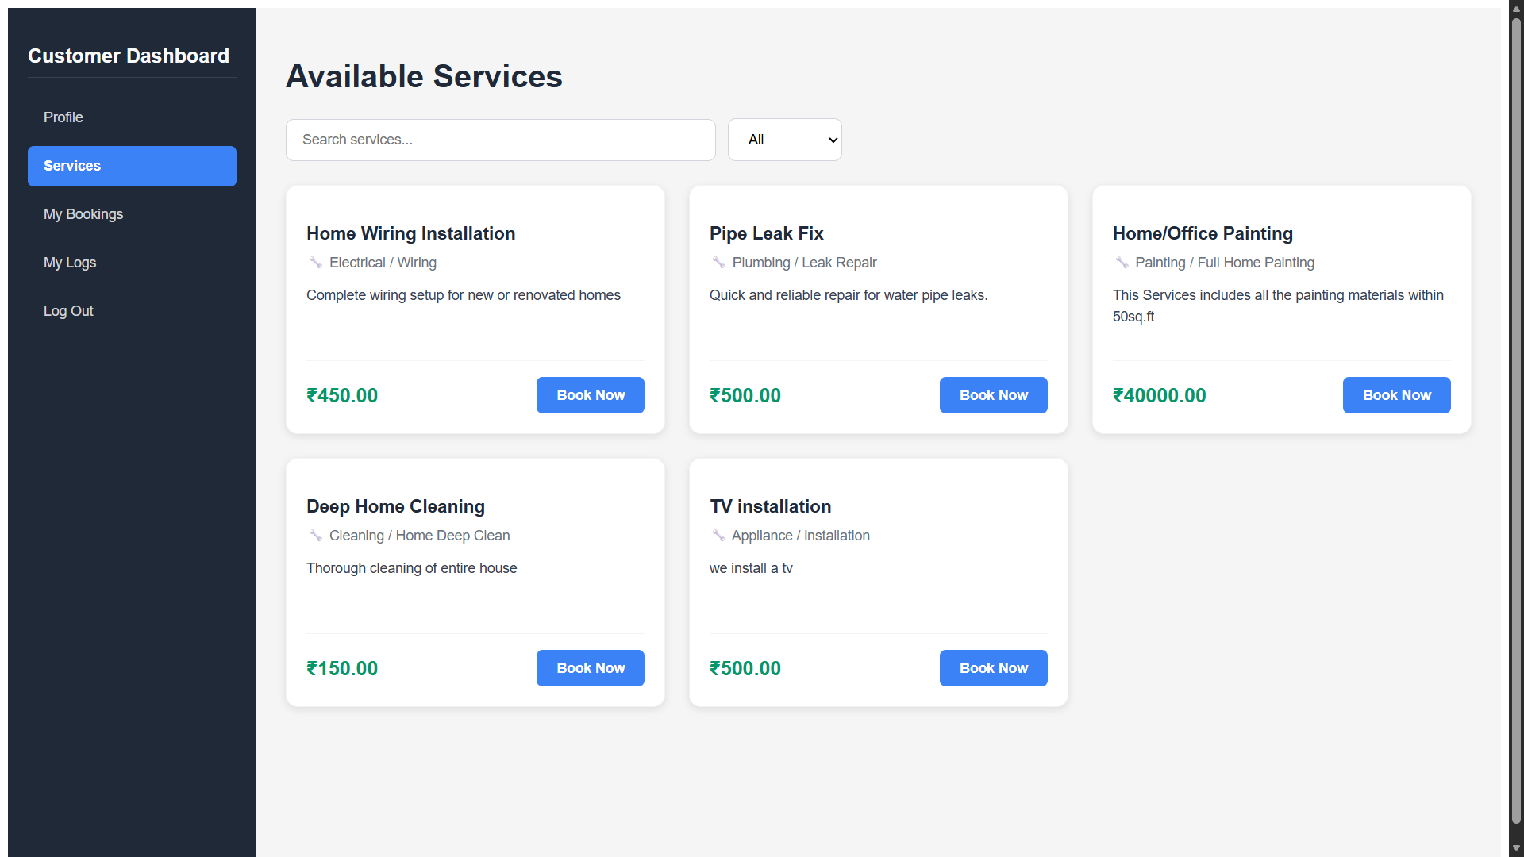
Mepco Schlenk Engineering College (Autonomous)
Customer Dashboard – Services
7 November 2025
7 November 2025
7 November 2025
Department of Computer Science and Engineering
32

Slide 33
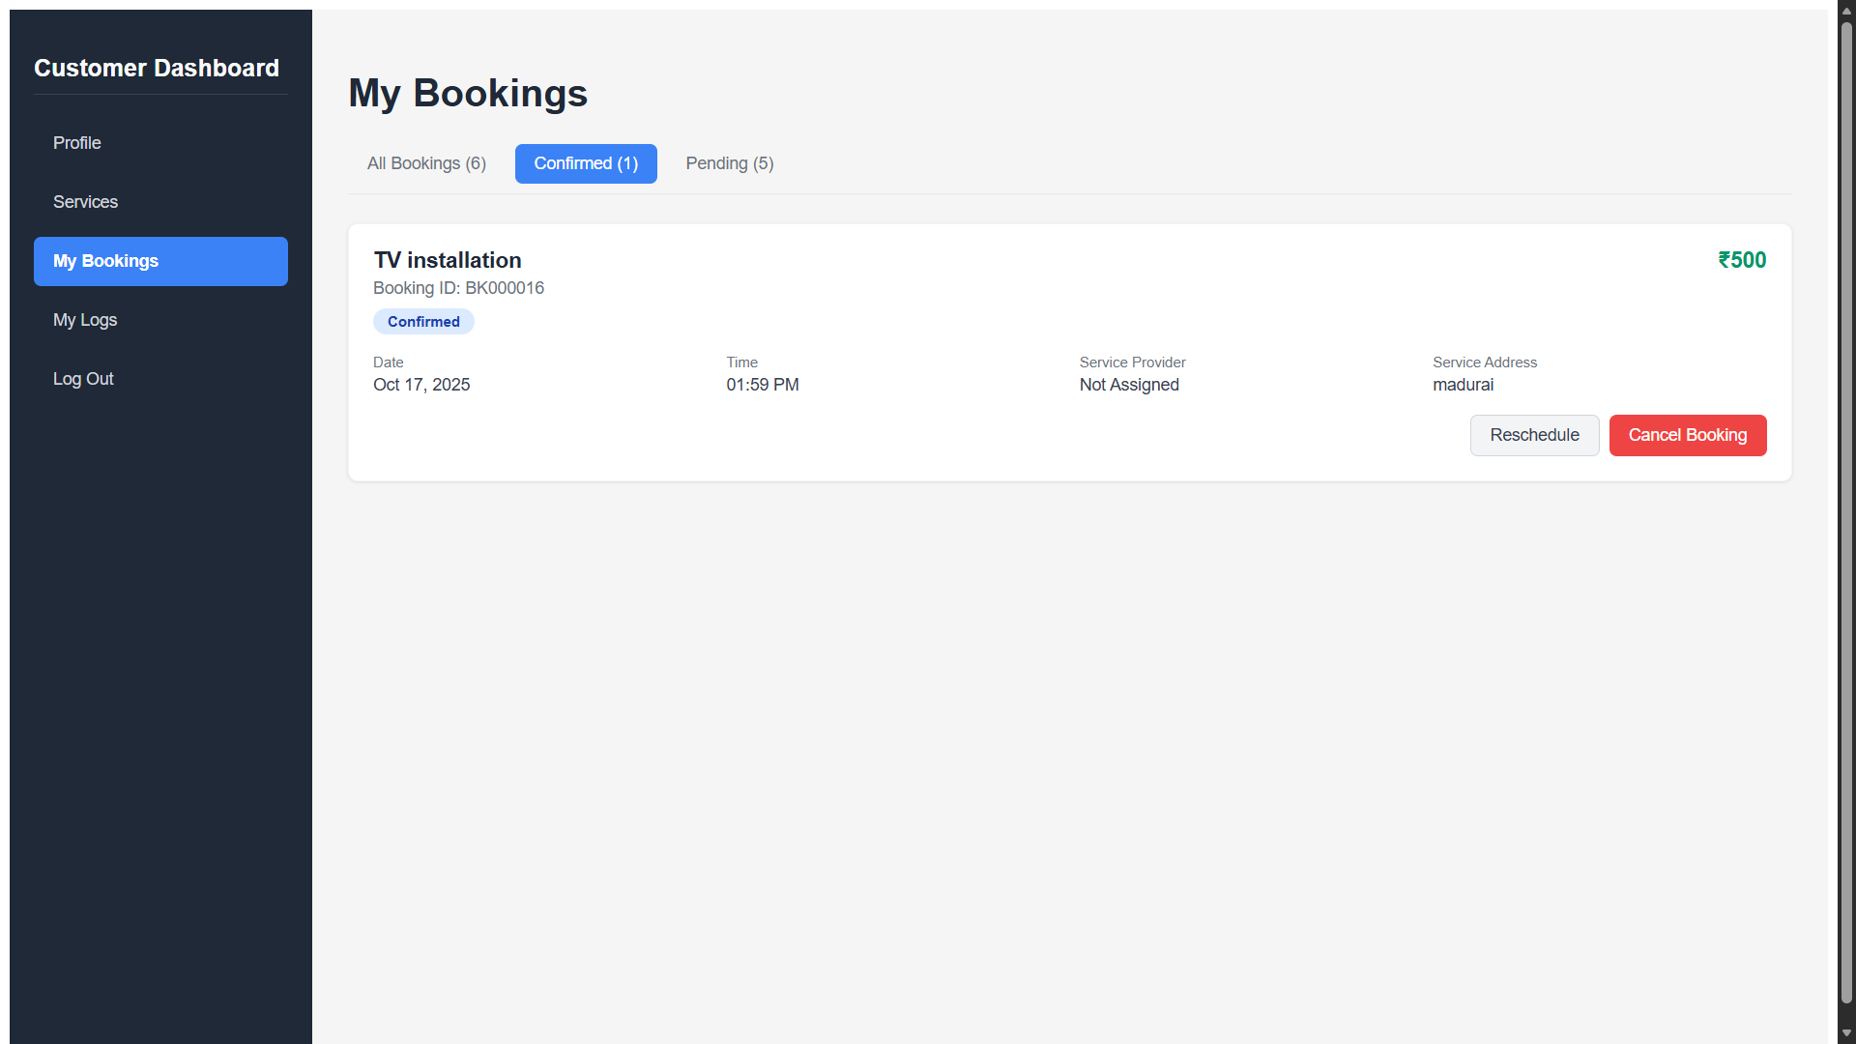
Mepco Schlenk Engineering College (Autonomous)
Customer Dashboard – Bookings:
7 November 2025
7 November 2025
7 November 2025
Department of Computer Science and Engineering
33

Slide 34
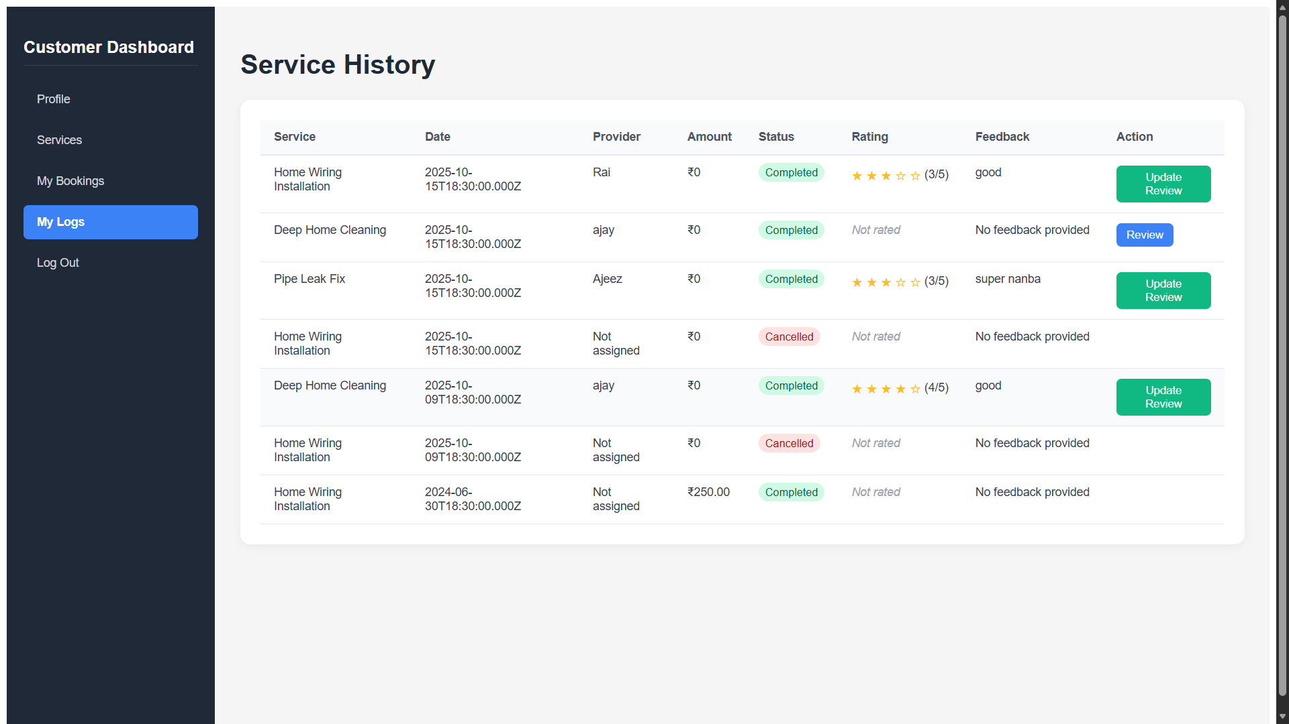
Mepco Schlenk Engineering College (Autonomous)
Customer Dashboard – Services history:
7 November 2025
7 November 2025
7 November 2025
Department of Computer Science and Engineering
34

Slide 35
Mepco Schlenk Engineering College (Autonomous)
References:
https://handymansingapore.org/ - Pro Handyman Singapore provides trusted, high-quality handyman services across Singapore—offering plumbing, lighting installation, air conditioner servicing, door repairs, and more with prompt, professional, and cost-effective expertise.
https://enquire.smshandyman.com.sg/ - SMS Handyman is a trusted, HDB- and BCA-licensed specialist in Singapore, offering reliable rubbish chute maintenance and door repair services with over 9 years of experience.
https://en.wikipedia.org/wiki/Handyman – Handyman is a multi-skilled professional specializing in home and property maintenance, performing tasks such as minor electrical, plumbing, carpentry, and repair work to keep spaces functional and well-maintained.
https://www.everyworks.com/ – Everyworks Group is Singapore’s leading home maintenance company offering comprehensive handyman, plumbing, electrical & air-con services with transparent quotes and island-wide coverage.
7 November 2025
7 November 2025
7 November 2025
Department of Computer Science and Engineering
35

Slide 36
Mepco Schlenk Engineering College (Autonomous)
THANK YOU
7 November 2025
7 November 2025
7 November 2025
7 November 2025
7 November 2025
7 November 2025
7 November 2025
Department of Computer Science and Engineering
36

